Slide 1
Introduction to 8086 Microprocessor

Slide 2
Clock Speed
Also called clock rate, the speed at which a microprocessor executes instructions.
The CPU requires a fixed number of clock ticks (or clock cycles) to execute each instruction.
The faster the clock, the more instructions the CPU can execute per second.
Clock speeds are expressed in megahertz (MHz) or gigahertz (GHz).
Every computer contains an internal clock that regulates the rate at which instructions are executed and synchronizes all the various computer components.
A computer with a clock speed of 800MHz is running 800,000,000 cycles per second, while a 2.4GHz computer is running 2,400,000,000 cycles per second.

Slide 3
Uses of transistors in computer
Transistors are the building block of computers. It is widely used in CPU and memory.
The property of the transistor, being able to switch between two different states (on-off) is very important for a computer's function. In a computer the transistor can be made to switch between two binary states called 0 and 1. The simple switch operation of transistors is what enables computer to complete massively complex tasks. One computer chip can have millions of transistors continually switching, helping complete complex calculations.. In a computer it is not present as a single isolated item, instead it is part of something that is called an integrated circuit.
Every memory location will have a pair of transistors, so there are 16 of them for each byte, so 16 million of them for each megabyte of memory.

Slide 4
Moor’s Law
An observation made by Intel co-founder Gordon Moore in 1965. He noticed that the number of transistors per square inch on integrated circuits had doubled every year since their invention. Moore’s law predicts that this trend will continue into the foreseeable future.
Although the pace has slowed, the number of transistors per square inch has since doubled approximately every 18 months. This is used as the current definition of Moore's law.

Slide 5
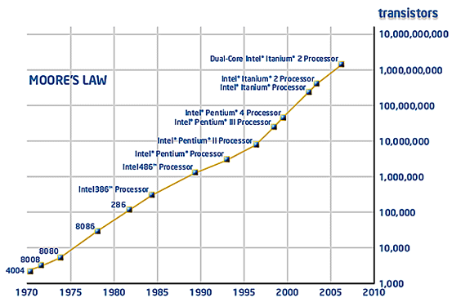

Slide 6
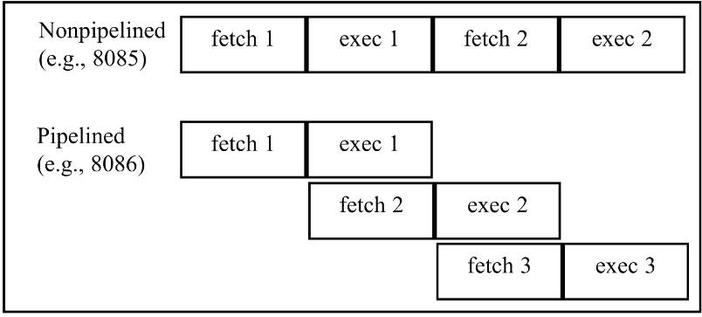
8088/86 pipelining
8085 is not pipelined microprocessor.
  The idea of pipelining in its simplest form is to allow the CPU to fetch and execute at the same time.

Slide 7
8086 Microprocessor
Belongs to a popular microprocessor series
  8086, 80186, 80286, 80386, 80486, Pentium
INTEL launched 8086 in 1978
8086 is a 16-bit microprocessor with
  16-bit Data Bus
  20-bit Address Bus

Slide 8
Features
It is a 16-bit μp.
8086 has a 20 bit address bus can access up to 2²⁰ memory locations (1 MB).
It has multiplexed address and data bus AD0- AD15 and A16 – A19.
It requires +5V power supply.
A 40 pin dual in line package.
8284 clock generator is used to generate clocked input signal.

Slide 9
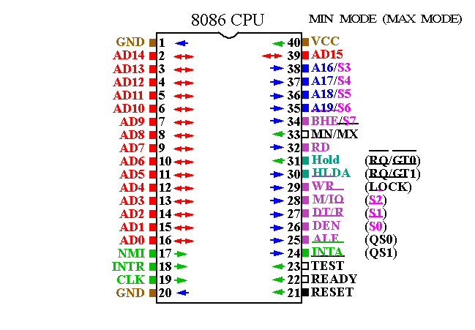
8086

Slide 10
Features
An 8086 word in memory consists of any two consecutive bytes.
Smaller address contain the low byte of the word, while higher address contain the higher byte.
If the first byte is at even address 8086 can access the entire word in one operation.
If the first byte is at odd address , it requires two bus operation to access the whole word.

Slide 11
Features
Can be configured as minimum mode:
  Support small, single processor system.
Can be configured as maximum mode:
  Support multiprocessor systems.

Slide 12
8086 Internal Architecture
8086 employs parallel processing
8086 CPU has two parts which operate at the same time
  Bus Interface Unit
  Execution Unit
CPU functions
  Fetch
  Decode
  Execute
8086 CPU
Bus Interface
Unit (BIU)
Execution Unit
(EU)

Slide 13
Bus Interface Unit
The BIU handles all transactions of data and addresses on the buses for EU.
The BIU performs all bus operations such as instruction fetching, reading and writing operands for memory and calculating the addresses of the memory operands.
The instruction bytes are transferred to the instruction queue.

Slide 14
Bus Interface Unit
Sends out addresses for memory locations
Fetches Instructions from memory
Reads/Writes data from/to memory
Sends out addresses for I/O ports
Reads/Writes data from/to Input/Output ports

Slide 15
Execution Unit
Tells BIU (addresses) where to fetch instructions or data
Decodes & Executes instructions
EU executes instructions from the instruction system byte queue.
Dividing the work between BIU & EU speeds up processing

Slide 16
Architecture Diagram of 8086

Slide 17
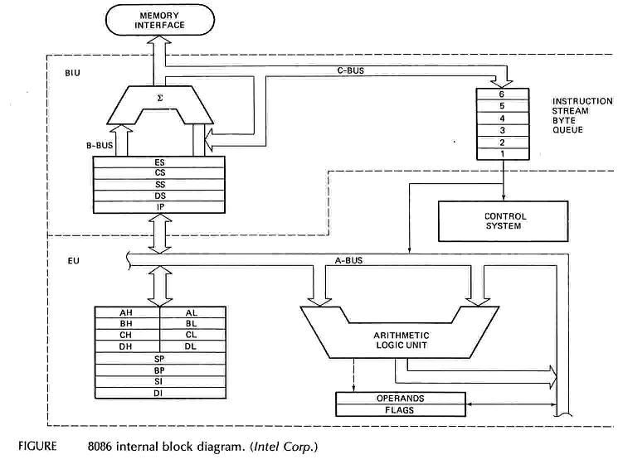
Intel 8086 Internal Architecture

Slide 18
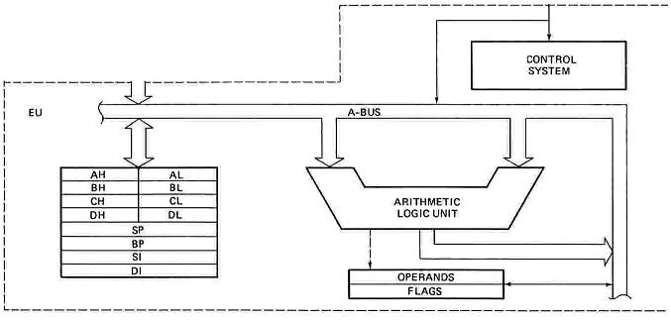
Execution Unit
Main components are
  Instruction Decoder
  Control Circuitry
  Arithmetic Logic Unit
  General Purpose Registers
  Pointer & Index registers
  Flag Register

Slide 19
Instruction Decoder
Translates instructions fetched from memory into a series of actions which EU carries out
Control Circuitry
Generates timing and control signals to perform the internal operations of the microprocessor
Arithmetic Logic Unit
EU has a 16-bit ALU which can ADD, SUBTRACT, AND, OR, increment, decrement, complement or shift binary numbers

Slide 20
Registers in EU
16 bits
16 bits
8 bits
8 bits
8 bits
8 bits
AH | AL
BH | BL
CH | CL
DH | DL
SP
BP
SI
DI
Accumulator
AX
Accumulator
Base
BX
Base
Count
CX
Count
DX
Data
Data
Stack Pointer
Stack Pointer
Pointer
Base Pointer
Base Pointer
Source Index
Source Index
Index
Destination Index
Destination Index

Slide 21
General Purpose Registers
EU has four 16-bit general purpose registers
Each of them can be used two independent 8-bit registers.
Two registers can also be combined to form 16-bit registers
The valid register pairs are – AX, BX, CX, DX
AH | AL | AX
BH | BL | BX
CH | CL | CX
DH | DL | DX

Slide 22
General Purpose Registers
AX/AL register is also called Accumulator
  Must be used in multiplication and division operations
  Must also be used in I/O operations
  MUL BH;AL times BH, result in AX
BX is known as Base Register
  Only general purpose register whose content can be used for addressing 8086 memory.
  DS is the default segment register.

Slide 23
General Purpose Registers
CX register is also called Counter Register
  Used as a loop counter
  Used in shift and rotate operations
DX is known as Data Register
  Used in multiplication and division
  Used to hold high 16 bit result of 16×16 bit multiplication.
  Used to hold high 16 bit dividend before 32÷16 bit division and 16 bit remainder after division

Slide 24
Pointer Registers
Contain the offset addresses of memory locations
Can also be used in arithmetic and other operations
SP: Stack pointer
  Used with SS (Stack Segment) register to access the stack segment.
  Stores an offset from the current SS.
  SP contents are automatically updated due to execution PUSH/POP instruction.
BP: Base Pointer
  Primarily used to access data on the stack segment
  Can be used to access data in other segments

Slide 25
Index Registers
SI: Source Index register
  is required for some string operations
  When string operations are performed, the SI register points to memory locations in the data segment which is addressed by the DS register. Thus, SI is associated with the DS in string operations.
DI: Destination Index register
  is also required for some string operations.
  When string operations are performed, the DI register points to memory locations in the data segment which is addressed by the ES register. Thus, DI is associated with the ES in string operations
The SI and the DI registers may also be used to access data stored in arrays

Slide 26
Flag Register
8086 has a 16-bit flag register
Contains 9 active flags
There are two types of flags in 8086
  Conditional flags – six flags, set or reset by EU on the basis of results of some arithmetic operations
  Control flags – three flags, used to control certain operations of the processor

Slide 27
Flag Register
U | U | U | U | OF | DF | IF | TF | SF | ZF | U | AF | U | PF | U | CF
1. | CF | CARRY FLAG | Conditional Flags
2. | PF | PARITY FLAG
3. | AF | AUXILIARY CARRY
4. | ZF | ZERO FLAG
5. | SF | SIGN FLAG
6. | OF | OVERFLOW FLAG
7. | TF | TRAP FLAG | Control Flags
8. | IF | INTERRUPT FLAG
9. | DF | DIRECTION FLAG

Slide 28
Flag Register
Flag | Purpose
Carry (CF) | Holds the carry after addition or the borrow after subtraction.
Parity (PF) | PF=0; if the result has odd parity, PF=1;even parity.
Auxiliary (AF) | is set(AF=1) if there is a carry from low nibble to high nibble or a borrow from a high nibble to low nibble of the low order 8-bit of a 16-bit number.(for example, in BCD addition or subtraction.)
Zero (ZF) | Shows the result of the arithmetic or logic operation. Z=1; result is zero. Z=0; The result is not 0
Sign (SF) | Holds the sign of the result after an arithmetic/logic instruction execution. S=1; negative(MSB=1), S=0

Slide 29
Flag | Purpose
Trap (TF) | A control flag. Enables the trapping through an on-chip debugging Feature(if TF=1).
Interrupt (IF) | A control flag. Controls the operation of the INTR (interrupt request) IF=0; INTR pin disabled. IF=1; INTR pin enabled.
Direction (DF) | A control flag. It selects either the increment or decrement mode for DI and /or SI registers during the string instructions. If DF=1 SI/DI auto-decremented if DF=0 auto-incremented
Overflow (OF) | Overflow occurs (OF=1) when signed numbers are added or subtracted. An overflow indicates the result has exceeded the capacity of the Machine

Slide 30
Execution unit – Flag Register
Addition of two numbers:
0101 0100 0011 1001
0100 0101 0110 1010
1001 1001 1010 0011
CF | 0
PF | 1
AF | 1
ZF | 0
SF | 1

